Slide 1

PMP „The Future of Cyber Security and AI“ (Chair: Prof. Dr. Axel Lehmann)
PMP-Website: www.unibw.de/infosecur

Slide 2
PMP „Future of Cyber Security and AI“ – Activities 2024 - 2025
* 6 Planning (Zoom)-meetings
* Contribution to Executive Summary of the 56th Session of the International Seminars on Planetary Emergencies
* Planning Programme, Speakers etc. of the EMFCSC International School “AI Technology and Law”
* Planning Topics, Speakers for PMP-Meeting and Plenary Session in August 2025

Slide 3
International School on „AI Technologies and Law“
PMP Proposal:
Accepted by EMFCSC: February 27, 2025
Co-Directors: P.Duggal, P.P. Menchetti, A.Lehmann
Dates: 1st Course: April 27 to May 1, 2026; 2nd Course: September 1 to 6, 2026
Course Structure / Modules
(1) AI Basics
(2) Examples of AI Tools and Applications
(3) Governance, Regulatory and Legal issues related to AI
(4) Cybersecurity related to AI
(5) Ethical and Social Implications

Slide 4
PMP “Future of Cybersecurity and AI”
Major Agenda Topics (Meeting on August 8th):
Presentations:
- “Quantum Cryptography and Cybersecurity”, Charles Bennett
- “AI Risks - from geopolitical, economical, societal point of view”, Simon Greenman
- “AI Technology for Global Peace and Science Diplomacy”, Daniele Pulcini
- “Application of AI in Building Smart and Resilient Cities”, Shaika Al-Sanad

Slide 5
PMP “Future of Cybersecurity and AI”
Major Agenda Topics (Meeting on August 8^{t}):
International School on “AI Technologies and Law” :
- Status report
- Planning process for the first 2 Courses to be held in April and September 2026 (milestones, potential speakers, etc.)
Joined PMP-Meeting with PMP “Mitigation of Catastrophic Risks”:
- “The use of AI Tools in Arms Control”, John Organak / William Barletta,
- “The Ethical Use of AI in Negotiations”, Anna Pouliou

Slide 6
Presentations at the 2025 Plenary Session on Planetary Emergencies:
Charles Bennett:
Quantum cryptography and cybersecurity
Simon Greenman:
AI and generative AI from a technological and capability perspective
Alex Ntoko:
Data, AI, and knowledge robots: enhancing performance through synergy
Anna Pouliou:
Global political tensions and the future of the AI regulatory framework
Shaika Al-Sanad:
Cybersecurity challenges in building AI-driven smart cities
Daniela Mainenti:
Cybersecurity and Organized crime: AI as a tool for criminal governance
Pier Paolo Menchetti:
AI’s impact in advanced medical research and biotechnologies
Sun Kun Oh:
AI challenges for high energy physics and astrophysics

Slide 7
Conclusions (1)
Major technical Challenges & Obligations for the Scientific Community:
-> Foundations for Mastering the Complexity of Hyperconnectivity of “Systems-of-Systems”
-> Principles for Resilient System Design
-> Measures for interpretation, validation and credibility assurance of AI applications and results
-> Methods for Data Management (to ensure quality, authentification, privacy and security,

Slide 8
Conclusions (2) Major Ethical & Social Responsibilities for the Scientific Community:
Generate public and political Awareness of benefits and risks of Cyber Security and (generative) AI applications from an independent and multidisciplinary point of view;
Code-of-Conduct, Normative & Legal Basis for AI applications on a global scale
Provide framework for educational programmes on cyber security and AI for public, businesses, politics, …..
→ Establishment of an „ International School on AI Technologies and Law“ on behalf of EMFCSC (2 courses in 2026)

Slide 9
The PMP „The Future of Cyber Security and AI“
.. remembers his long-time PMP-colleague and friend:
Dr. Henning Wegener († 2024) Ambassador of Germany (ret.), Former Panel Chair (2001 - 2016), Berlin, Germany.

Slide 10
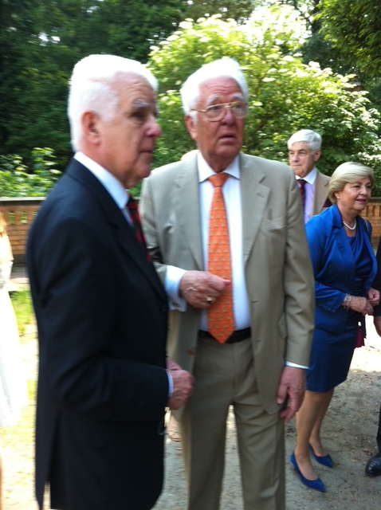
Berlin, Germany.

Slide 11
The PMP „The Future of Cyber Security and AI“
….. thanks
-> WFS for offering this great opportunity for multidisciplinary knowledge exchange
-> the audience in the Plenary session for the intensive discussion and fruitful feedback

